Slide 1
Artificial Intelligence: A Brief Historical Overview

Slide 2
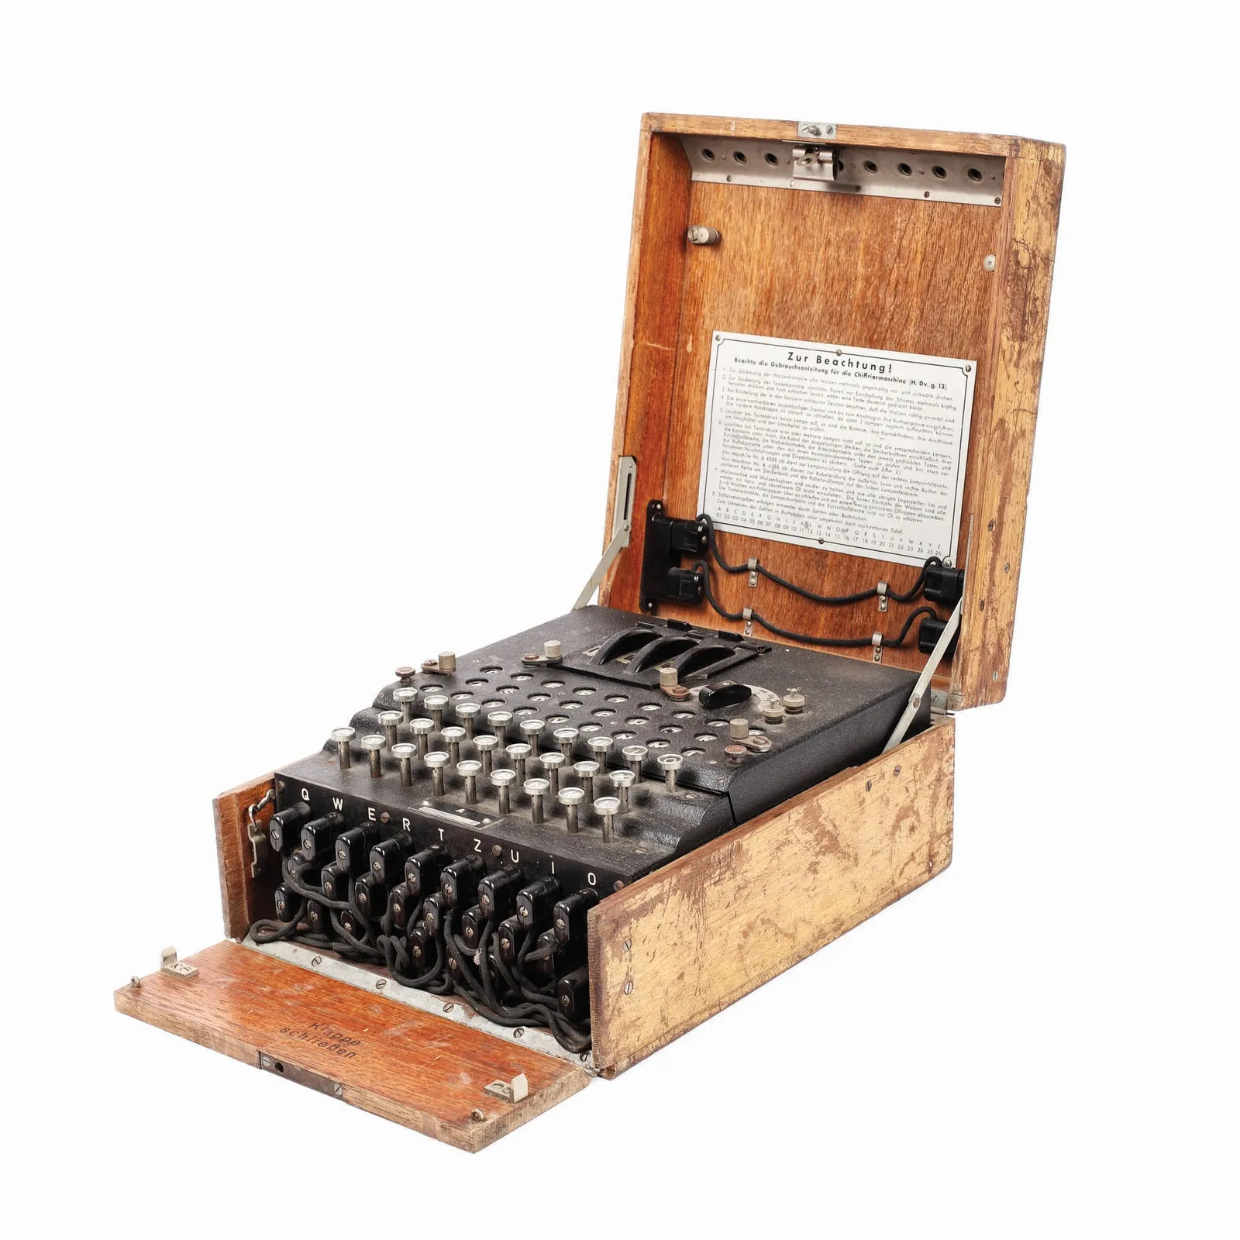
1940s-1950
Alan Turing cracked the German’s Enigma Machine encryption during WWII.
(1950) Turing hypothesized that computer programs could be taught to think like humans. He developed the “Turing Test” to put a computer’s behavior to the test to determine if it has “human intelligence;” it is still used today.
https://www.smithsonianmag.com/smart-news/wwii-enigma-machine-found-flea-market-sells-51000-180964053/

Slide 3
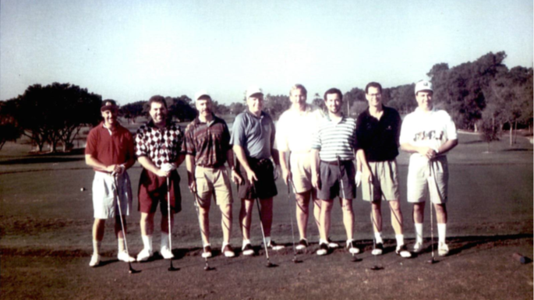

Slide 4
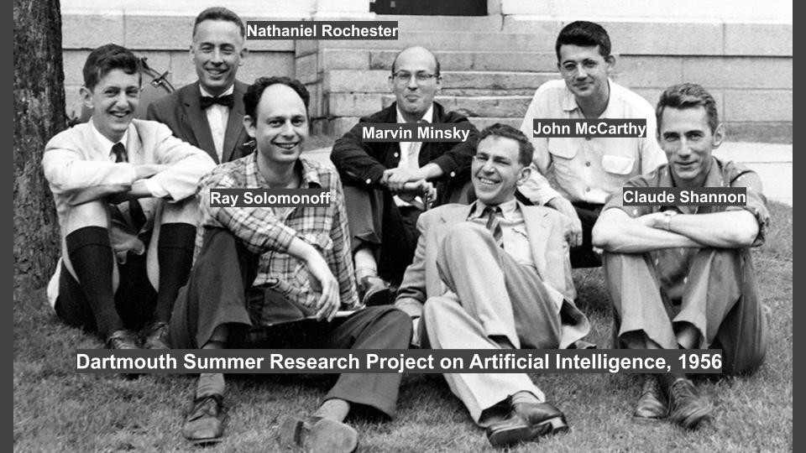
1950s
(1956) John McCarthy, an American computer and cognitive scientist, coined the term “artificial intelligence” during a workshop at Dartmouth College.
(1957) Frank Rosenblatt designs the first neural network for computers, which simulates the thought processes of the brain.
(1958) The U.S. Dept. of Defense forms the Advanced Research Projects Agency (now DARPA) to facilitate research and development of military and industrial strategies.
(1959-62) Arthur Samuel, an IBM computer scientist, created the first self-learning program, which was a game of checkers. Coined the term “machine learning.”

Slide 5
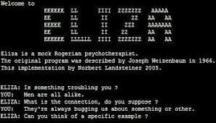
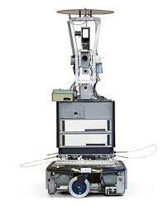
1960s
The U.S. Dept. of Defense began training computers to mimic basic human reasoning.
(1964-66) ELIZA was created at MIT A.I. Laboratory by Joseph Weizenbaum. Was created to show the superficiality of communications between humans and machines, and “she” simulated conversations via pattern matching and substitution method to provide users the illusion of understanding. Was one of the first chatterbots.
(1966-72) Shakey the Robot, developed by SRI International, could perceive its surroundings, logically deduce implicit facts, navigate, make a plan to achieve a goal, monitor the execution of a plan in the real world, recover from errors in plan execution, improve its planning abilities through learning, and communicate in simple English.

Slide 6
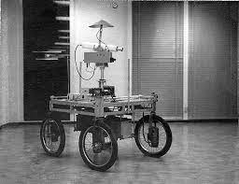
1970s-1980s
Researchers develop more expert systems with applications in biology, medicine, engineering, and the military.
Jane Robinson and Don Walker establish a Natural Language Processing group at SRI.
(1979) The Stanford Cart, built by Hans Moravec, is the first computer-controlled autonomous vehicle after circumnavigating a chair-filled room at the Stanford AI Lab.

Slide 7
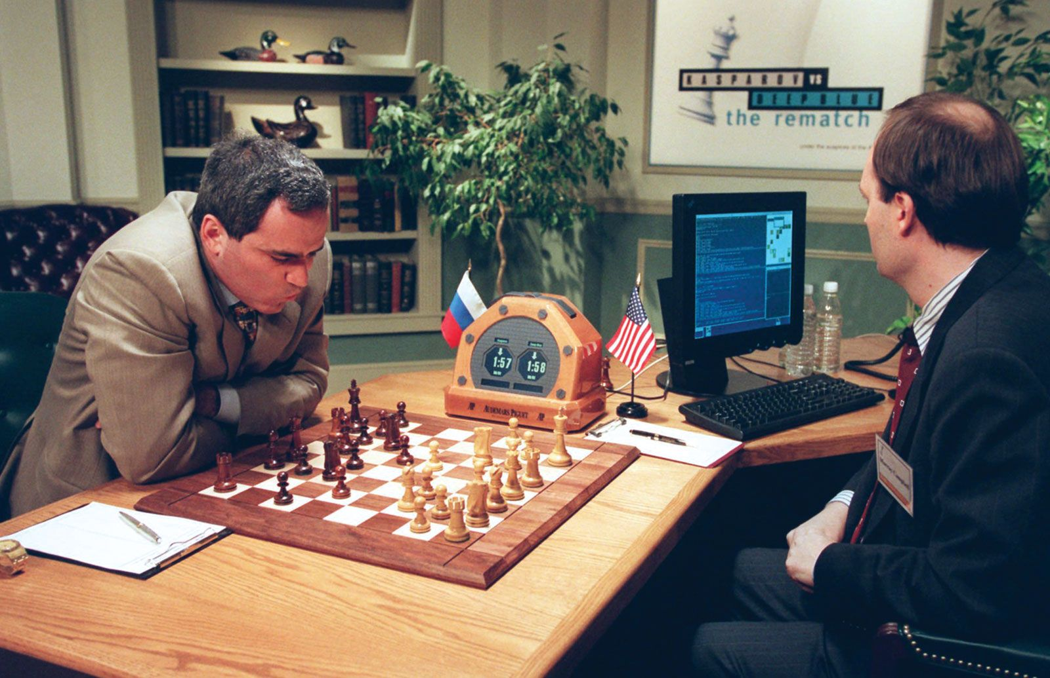
1990s
Work on machine learning shifts from knowledge-driven approaches to data-driven. Scientists began creating computer programs to analyze vast amounts of data and to draw conclusions or “learn” from the results.
(1991) U.S. military uses the DART program to schedule the transportation of supplies or personnel and to solve other logistical problems. It uses intelligent agents to aid decision support systems local at the U.S. Transportation and European Commands.
(1997) IBM’s Deep Blue supercomputer defeats world chess champion Garry Kasparov in a pair of six-game chess matches. This win was widely viewed as a huge advance for A.I. In the previous year, in their first match, Kasparov defeated Deep Blue.
(1998) The Digital Millennium Copyright Act (DMCA) was implemented, which stemmed from two 1996 international treaties of the World Intellectual Property Organization (WIPO).

Slide 8
2000s
Machine learning research achieved widespread practical use in major software services and mobile devices.
Intuitive Surgical’s da Vinci becomes the first robotic-assisted surgical system to be approved by the FDA for general laparoscopic surgery. Has been used in over 3 million minimally invasive procedures—including urology, gynecology, general surgery, thoracic surgery, and cardiac surgery.
(2005) Sebastian Thrun and a team from Stanford AI Lab built a driverless car named Stanley. Became first autonomous vehicle to complete a 132-mile course in the Mojave Desert—winning the DARPA Grand Challenge.
(2006) Geoffrey Hinton coined the term “deep learning” to explain new algorithms that let computers recognize objects and text within images and videos.

Slide 9
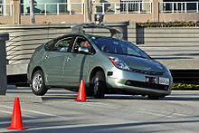
2000s Cont.
DARPA launches Urban Challenge for autonomous cars to obey traffic rules and operate within an urban environment.
AI Professor Noel Sharkey warns of an “emerging arms race among high-tech nations to develop autonomous submarines, fighter jets, battleships, and tanks that can find their own targets and apply violent force without the involvement of meaningful human decisions.”
(2009) Google builds a self-driving car.

Slide 10
2010s
Apple introduced Siri, a virtual assistant, for its iPhones. Siri uses voice queries and a natural language user interface to answer your questions, make recommendations, and perform actions by sending requests to a set of Internet services.
Microsoft Kinect for Xbox 360 tracks 20 human features at a rate of 30 times per second, which allows people to interact with the computer via movements and gestures.
IBM’s Watson defeats two of the best human players of the TV game Jeopardy—demonstrating an ability to understand and answer nuanced questions that had previously stumped computer programs.
(2013) Boston Dynamics unveils Atlas, an advanced humanoid robot designed for various search and rescue tasks.

Slide 11
2010s Cont.
Ian Goodfellow and his team invent generative adversarial networks, a type of machine learning framework applied for photo generation, image transformation, and deepfake creation.
Facebook introduces DeepFace, an AI system capable of facial recognition that rivals human capabilities.
Tesla and Ford announce timelines for fully autonomous vehicles.
Physicist Stephen Hawking warned about AI’s potential catastrophic consequences without adequate preparation and prevention.
OpenAI’s GPT-1 was introduced, laying the groundwork for future large language models (LLMs)

Slide 12
2020s
(2022) OpenAI launches ChatGPT, offering a chat-based interface to its GPT-3.5 LLM. After 5 days, the platform had already acquired over 1 million users.
(2023) OpenAI introduces the GPT-4 multimodal LLM for text and image prompts.
(2023) Elon Musk, Steve Wozniak, and others call for a six-month pause in training more advanced AI systems.

Slide 13
AI In the Law Today
Anderson et al. v. Stability AI Ltd. plaintiffs asserted that the models powering the defendants AI-powered image generating tools were trained using copyrighted images scraped from the internet (including their copyrighted works) without consent. The U.S. District Court for the Northern District of California dismissed most of the plaintiffs’ claims, with only one plaintiff’s direct copyright infringement claim against Stability AI surviving. The court granted leave to amend the complaint on most counts, and the plaintiffs have since filed an amended complaint.
Kadrey v. Meta Platforms (consolidated with Chabon v. Meta Platforms) Involved Meta’s LLaMA large language models (where plaintiffs allege were trained on their books). The amended complaint contains only a single claim, which is for direct copyright infringement based on copies made during the training of the models.
Thomson Reuters Enterprise Centre GmbH v. ROSS Intelligence Inc. filed in the U.S. District Court for the District of Delaware in May 2020, centers on allegations that copyrighted headnotes from Thomson’s Westlaw legal research database were used as training data for an AI legal research tool that was developed by ROSS Intelligence.
Microsoft, GitHub, and OpenAI have been sued in a proposed class action lawsuit alleging that these companies’ creation of AI-powered coding assistant GitHub Copilot relies on “software piracy on an unprecedented scale.” While this case has yet to be certified as a class, it could have broad effects on AI, where companies are making significant profits on training software that pulls from copyright-protected data.

Slide 14
What Questions are being asked?
Does training a model on copyrighted material require a license?
Does generative AI output infringe on copyrighted materials from where they are trained?
Does generative AI violate restrictions on removing, altering, or falsifying copyright management information?
Does generative work in the style of someone violate that person’s rights?
As all these cases continue and the courts provide answers to these questions, the conflict between AI and intellectual property rights will hopefully be resolved.

Slide 15
Law of the Horse
“Law of the Horse” was a term used in the mid 1990s to define the state of cyber law during the early years of the Internet
The term first gained prominence at a 1996 cyber law conference presentation by Judge Frank H. Easterbrook of the United States Court of Appeals for the 7th Circuit
Easterbrook, who was also on the faculty of the University of Chicago, later published his presentation in the University of Chicago legal forum as Cyberspace and the Law of the Horse, in which he argued against the notion of defining cyber law as a unique section of legal studies and litigation

Slide 16
Law of the Horse Cont.
Judge Easterbrook cited Gerhard Casper as coining the expression “Law of the Horse” and stated that Casper’s arguments against specialized or niche legal studies applied to cyber law:
…The best way to learn the law applicable to specialized endeavors is to study general rules. Lots of cases deal with sales of horses; others deal with people kicked by horses; still more deal with the licensing and racing of horses, or with the care the veterinarians give to horses, or with prizes at horse shows. Any effort to collect these strands into a course on the “law of the horse” is doomed to be shallow and to miss unifying principles.

Slide 17
The Horse Jumps the Rail
Judge Easterbrook’s theory was challenged by Lawrence Lessig, a professor at Harvard Law School, in a 1999 article, The War of the Horse: What Cyber Law Might Teach
Prof. Lessig’s article, which was first presented at the Boston University Law School faculty workshop, argued that legal perception and rules would need to evolve as the cyberspace environment developed and expanded
Fast-forward about 30 years, we now live in a world where life at once physical and digital…Since Judge Easterbrook’s presentation in the mid-1990s, we have seen the adoption of numerous state and federal laws related to technology and the Internet…to challenge us even further, AI is “out of the barn”

Slide 18
Mata v. Avianca
In Feb 2022, Mata filed an action alleging he was injured when a metal serving cart struck his knee during an international flight.
Avianca moved to dismiss Mata’s claims. Mata’s lawyers submitted filings in opposition.
In Avianca’s reply brief, Avianca’s attorneys explained they were “unable to locate” many authorities cited in the “Affirmation of Opposition.”
After the Court also could not locate the cases, it orders Mata’s attorney to file an affidavit attaching copies of the cited cases. His attorney submitted an affidavit purportedly containing all but one of the “decisions.”
In fact, the attached “decisions” were fabricated by ChatGPT when he asked the chatbot to identify favorable rulings addressing the issue in their case. He even asked the chatbot if they were “real,” only to be reassured that the cases “indeed exist” and “can be found in reputable legal databases such as LexisNexis and Westlaw.”

Slide 19
Darlene Smith v. Matthew Farwell & Others (Massachusetts)
Plaintiff, acting as the personal representative of her niece, commenced a wrongful death action against multiple defendants.
Defendants filed separate Motions to Dismiss, and Plaintiff submitted four separate memoranda of law in opposition to the Motions to Dismiss (the “Oppositions”).
Upon reviewing the Oppositions, the Court noted that the Plaintiff’s legal citations “seemed amiss.”
When Plaintiff’s Counsel was asked about the fictitious citations, he stated he didn’t know where or how the fictitious case citations were obtained. Plaintiff’s Counsel stated the Oppositions were prepared by interns in his office.
Plaintiff’s Counsel was ordered to file a written explanation of the origin of the fictious case citations. In his letter, Plaintiff’s Counsel acknowledged that the Oppositions included citations to multiple cases that do not exist, and he attributed the citations to an AI system that someone in his office used while researching. He apologized for his lack of due diligence in verifying the accuracy of the caselaw.

Slide 20
Smith Cont.
After further investigation, the Court found that the fake case citations appear in two of the Plaintiff’s Oppositions and that an additional fake case was cited in three of the Plaintiff’s Oppositions.
At the sanctions hearing, Plaintiff’s Counsel apologized to the Court and was adamant that the fictitious case citations were an accident, he was not familiar with AI technology, did not know AI technology was used to draft the Oppositions, and did not intend to deceive the Court.
The judge found that the Plaintiff’s Counsel violated Rules 7 and 11 of the Massachusetts Rules of Civil Procedure due to Counsel’s “lack of diligence and apparent failure to take seriously the responsibility of conducting litigation in compliance with the rules of civil procedure.”
The Court ordered Plaintiff’s Counsel to pay $2,000.00 to the Clerk of Court as a sanction for violating Rules 7 and 11 of Massachusetts Rules of Civil Procedure.
The judge explained the sanction is mild in this case due to the Court’s acceptance of Plaintiff’s Counsel’s representations that he is generally unfamiliar with AI technology, that he had no knowledge that an AI system had been used, and the fictitious citations were included in error and not with the intention of deceiving the Court.

Slide 21
Practical Lessons from the Attorney AI Missteps in Mata v. Avianca
Attorneys can avoid the missteps (and sanctions) in Mata by doing the following:
1. Become familiar with the strengths and limitations of AI
2. Verify AI work product and identify tasks only attorneys can perform
Judge Castel emphasized attorneys taking a “gatekeeping role” to “ensure the accuracy of their filings.”
3. Correct mistakes immediately if discovered
For example, In Mata, “no Respondent sought to withdraw the March 1 affirmation” containing the fake cases.

