Slide 1
Artificial Intelligence in Workers Compensation: Risks and Opportunities
Brian J. Lamoureux, Esq.
Pannone Lopes Devereaux & O’Gara LLC
© Brian J. Lamoureux

Slide 2
Today’s docket
Introduce and demystify ChatGPT and AI tools
How AI works
Explain current limitations
How it’s being used, generally
How it’s being used in the law and in courts
What lawyers and judges should be thinking about
Special considerations for workers’ comp context
ChatGPT demonstration
Questions (including as we go)
© Brian J. Lamoureux

Slide 3
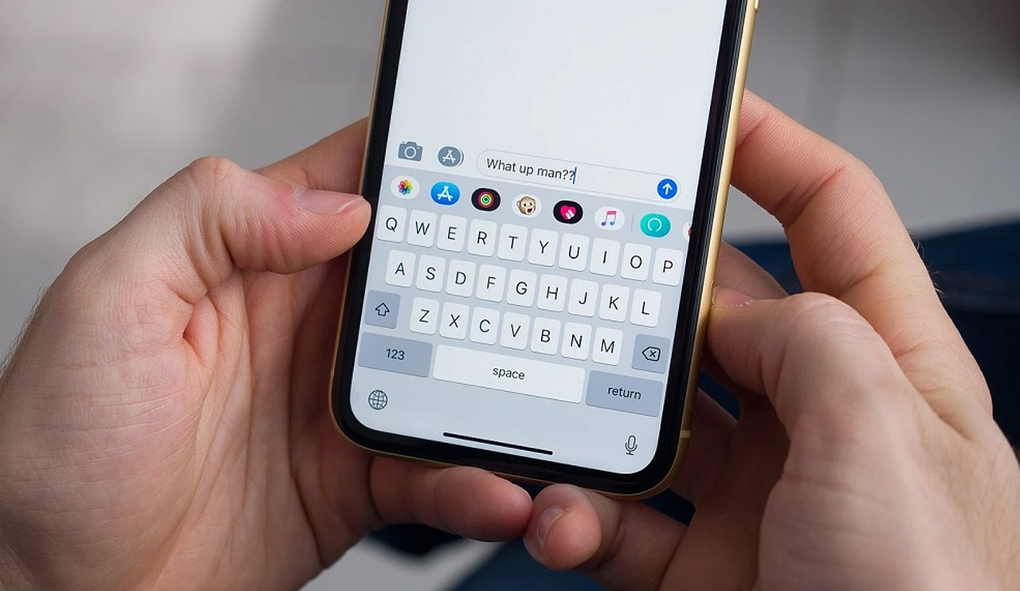
But first, a quick poll
https://www.polleverywhere.com/activities?folder=17780577
© Brian J. Lamoureux

Slide 4
Most popular AI tools:
ChatGPT (OpenAI)
Dall-E (image generation)
Bard/Gemeni (Google)
Sora (OpenAI) – image & video generation
CoPilot (Microsoft add-on to Outlook, Excel, etc.)
© Brian J. Lamoureux

Slide 5
How does it work?
© Brian J. Lamoureux

Slide 6
GPT=“generative pre-trained transformer”
© Brian J. Lamoureux

Slide 7
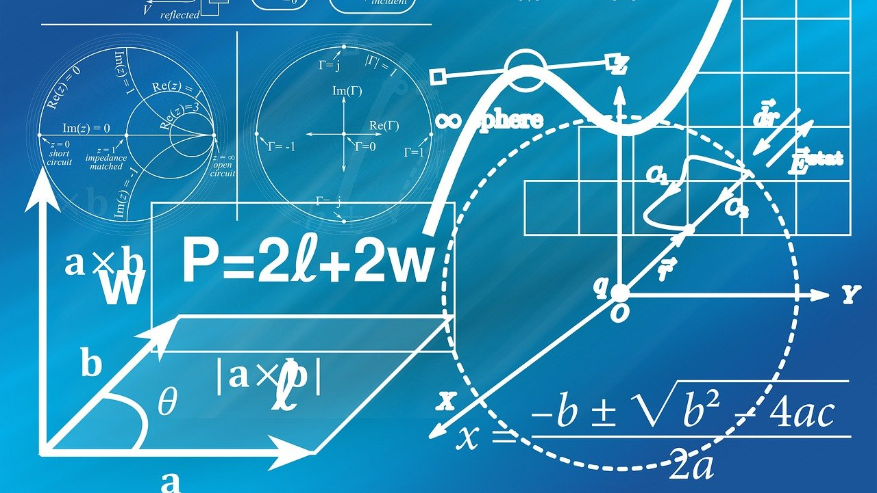
How it works in one word:
MATH
© Brian J. Lamoureux

Slide 8
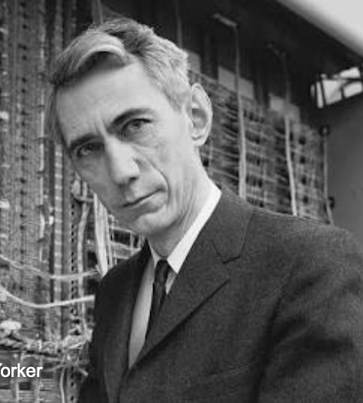
Who is Claude Shannon?
Mathematician from 1940’s
Devised a clever word experiment
Opened a book to random page
Started with the word “The” and picked the next word after it (“head”)
Picked another random page, read until he found the word “head,” then picked the next word after it, etc.
Result? “The head and in frontal attack on an English writer that the character of this point is therefore another method.”
© Brian J. Lamoureux

Slide 9
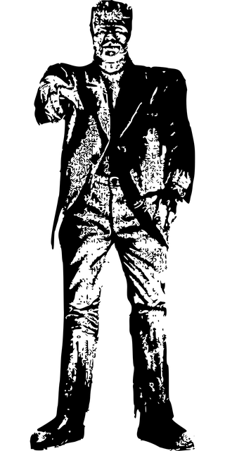
Claude Shannon 2.0
Later mathematicians did the same thing as Shannon, but this time used phrases, not single words.
The result from Shelley’s Frankenstein?
“I continued walking in this…” (look for another phrase elsewhere in the book after the word “this”)
“I continued walking in this manner for some time, and I feared the effects of the daemon’s disappointment.”
© Brian J. Lamoureux

Slide 10
AI Tools do the same thing, but…
With a staggeringly large data set, called a Large Language Model (LLM)
ChatGPT’s data set is 300 billion words
Really really really really FAST
Learns and improves over time by accepting Reinforcement Learning from Human Feedback (RLHF)
“That wasn’t really funny.”
“Are you sure? The World Atlas shows that the capital of The Netherlands is Amsterdam.”
© Brian J. Lamoureux

Slide 11
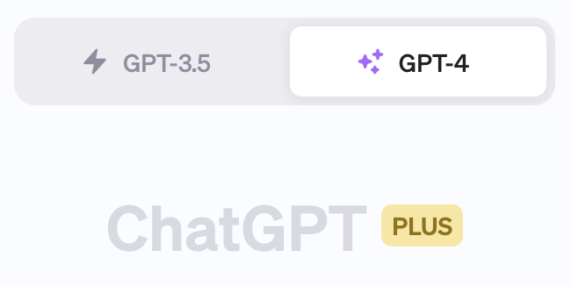
CHATGPT DEMONSTRATION (at end)
© Brian J. Lamoureux

Slide 12
DALL-E DEMONSTRATION
https://labs.openai.com/
© Brian J. Lamoureux

Slide 13
SORA DEMONSTRATION
https://openai.com/sora
© Brian J. Lamoureux

Slide 14
What are AI’s current limitations?
Outdated or incomplete data sets
Lack of contextual understanding (“vacuum effect”)
Inability to grasp nuance or cultural tones/shades
Can (confidently) produce factually inaccurate information or “hallucinate”
Bias
Over-trust and over-reliance by non-AI beings (i.e., humans)
© Brian J. Lamoureux

Slide 15
Wait, what?
© Brian J. Lamoureux

Slide 16
Wait, what?
© Brian J. Lamoureux

Slide 17
Wait, what?
© Brian J. Lamoureux

Slide 18
How it’s being used, generally
Healthcare (diagnostics, image reading and interpretation, scripting messaging to patients and families)
Fraud detection (pattern recognition)
Customer service and interactions
Self-driving cars, route optimization, traffic management
Consumer benefits (finding lowest prices, suggesting alternatives)
Energy (grid management – “going to where the puck will be”)
Education (learning methods, “assisting” students in problem-solving)
Retail (inventory management, price research, delivery optimization)
Media and entertainment
Security (facial and gait recognition)
Agriculture (crop rotation and management optimization)
Manufacturing (quality control, enhance efficiencies, quality assurance)
© Brian J. Lamoureux

Slide 19
© Brian J. Lamoureux

Slide 20
How can AI be used in the law and in courts?
By lawyers:
Research
Write briefs
Create outlines for witness depositions and directs/cross-examinations
Draft documents (contracts, severance agreements, orders, etc.)
Review document sets
Predictive analysis (likelihood of success)
Case management (scheduling, conflicts, planning)
Client interaction (office management)
© Brian J. Lamoureux

Slide 21
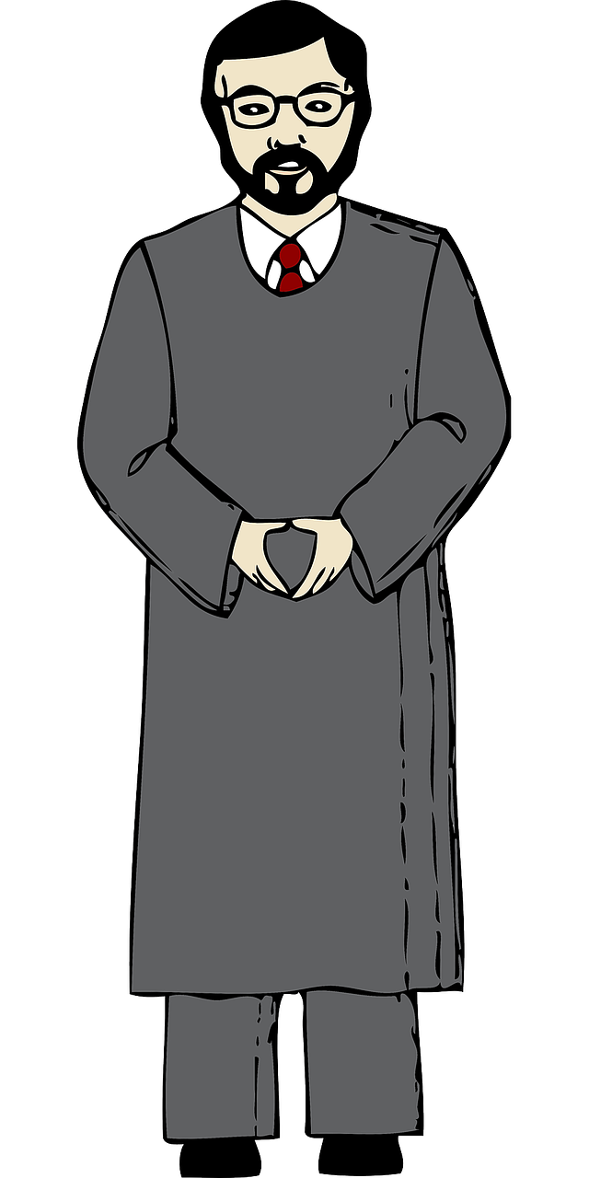
How can AI be used in the law and in courts?
By judges
Research
Draft documents such as orders, decisions, and judgments
Monitoring compliance with probation or conditional sentence (raise red flag if pattern or risk is detected)
Administrative Tasks
Data analytics (identify larger trends about case types, dispositions, potential biases/discrimination)
© Brian J. Lamoureux

Slide 22
What lawyers should be thinking about
Not if, but when (now)
Automated brief writing (upload documents produced, discovery responses, briefing) – RULE 11
In 202[?], it will likely be malpractice (below the standard of care) *NOT* to use AI tools
Clients’ best interests, often efficiency and cost reduction
Data privacy concerns
Client confidentiality using AI to upload or discuss potentially identifying client information (Rules of Professional Conduct)
Waiver of privilege concerns
Complications with conducting ESI discovery (spoliation/preservation)
© Brian J. Lamoureux

Slide 23
Bar Conference Preview – Rules of Prof. Conduct
Diligence
Competence
Limited Scope Representation
Confidentiality
Declining/terminating representation
Adequate supervision of staff and junior attorneys
Candor toward tribunal
Unauthorized practice of law
Rule 11
© Brian J. Lamoureux

Slide 24
© Brian J. Lamoureux

Slide 25
© Brian J. Lamoureux

Slide 26
© Brian J. Lamoureux

Slide 27
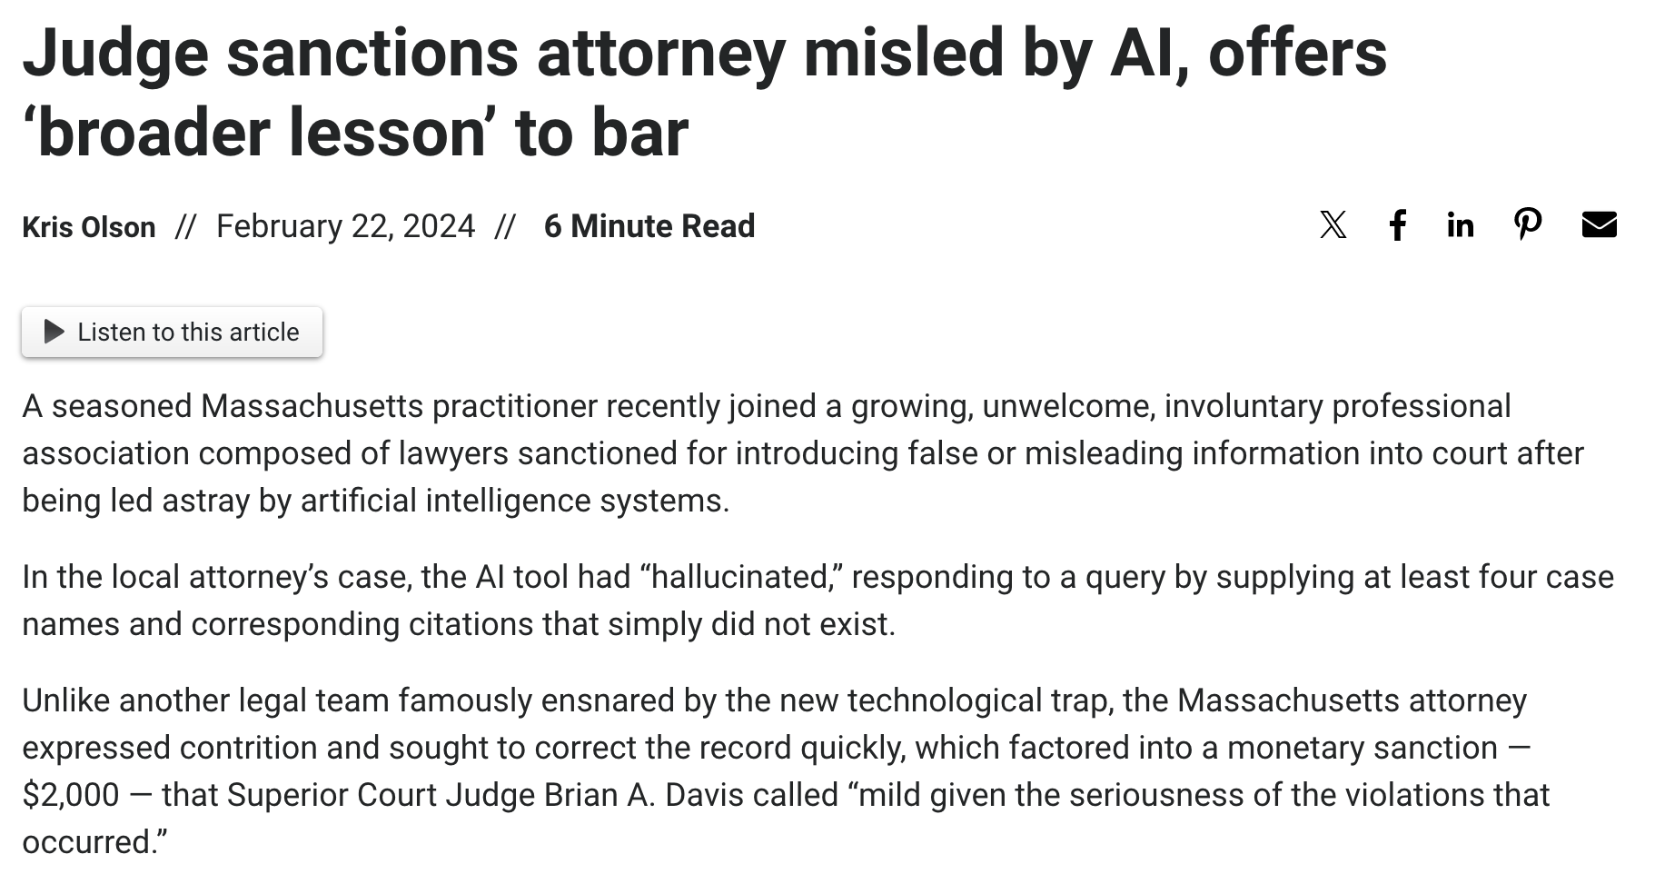
© Brian J. Lamoureux

Slide 28
Workers’ Comp Context – For Insurers/Adjusters
Risk Assessments – by looking at claims data, environmental factors, and safety records, AI models can spot past patterns (and therefore future risks) in the workplace.
Fraud/abuse detection – AI can aggregate and analyze claimant behavior, social media posts, medical records/information, claim history, etc.
Vetting medical providers – insurers using AI can analyze medical outcomes and identify efficient and effective medical providers.
Unnecessary medical treatments/intervention – AI can be used to red flag medical treatments and interventions that may be unnecessary or unrelated to the workplace injury
© Brian J. Lamoureux

Slide 29
Workers’ Comp Context – For Insurers/Adjusters
Claims Processing – Over time, AI can learn and improve claims handling and processing by “lessons learned” and constant improvement.
Accident recreation videos – robust image and video generation models can be used to replicate (as a demonstrative) an accident or injury setting, using realistic faces, gaits, physiology, etc. (Pictures are worth a thousand words, videos are worth…?)
Predictive Outcome Modeling – over time, as more and more claims and settlement data are input in the models, insurers, adjusters, and attorneys can more reliably value claims and probable range of outcomes based upon numerous factors (injury, geography, court/judge, opposing counsel, etc.)
© Brian J. Lamoureux

Slide 30
Workers’ Comp Context – For Insurers/Adjusters
Natural Language Analytics – in addition to data analytics, AI natural language models can monitor communications between injured worker and claims adjustment team to spot potential litigation risk (i.e., “negative” rapport -> higher litigation potential).
© Brian J. Lamoureux

Slide 31
Workers’ Comp Context – For Lawyers
Data/File Analytics – store and analyze information about the client’s employer, injury details, and insurance/adjuster information. Can be used to calculate settlement value (ranges) and other risks inherent in the claim file.
Client Intake management – streamline client intake process, assess risk of non-payment (or other potential conflicts)
Discovery/document management – “smart document review” – tell the too what you’re looking for, who you’re deposing, etc.
Script Witness Q&A – draft/outline scripts for depositions or trial based upon documents/briefs and legal issues to be tried
© Brian J. Lamoureux

Slide 32
Demonstration - drafting
© Brian J. Lamoureux

Slide 33
Deposition Preparation
I am deposing a witness to a serious workplace injury.
Give me a list of topic areas I should explore and then draft me an extremely detailed list of questions to ask under each topic area.
Finally give me a list of documents I may want to use as exhibits during the deposition.
© Brian J. Lamoureux

Slide 34
Demonstration – caselaw
© Brian J. Lamoureux

Slide 35
Darocha v. Centrex
Summarize this decision for me and give me the key takeaways.
© Brian J. Lamoureux

Slide 36
Darocha v. Centrex
This case is not good for my client's current position in a pending case before the same court. Give me some critiques or arguments I can use against this decision.
© Brian J. Lamoureux

Slide 37
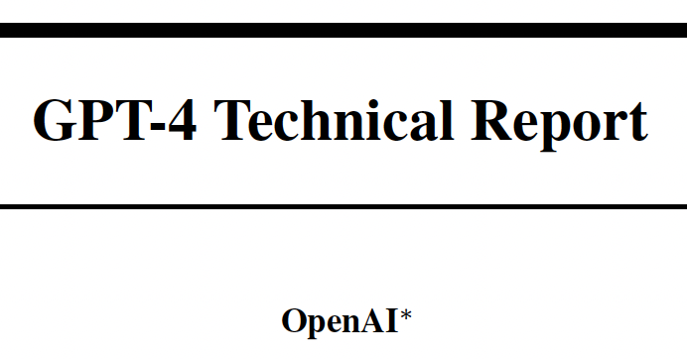
I’ll leave you with this…
© Brian J. Lamoureux

Slide 38
THANK YOU – Questions?
Brian J. Lamoureux, Esq.
bjl@pldolaw.com
© Brian J. Lamoureux

